Slide 1
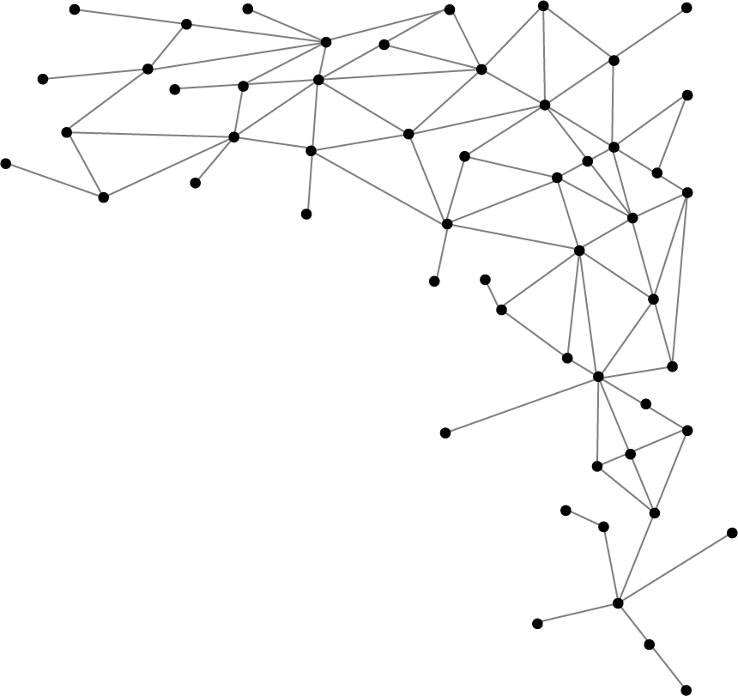




Machine Learning
I am Saif Hassan
Lecturer (CS@SIBAU)
@saifhassandr
@saifhassandr

Slide 2
Agenda
Titanic Dataset Example
Naïve Classifier
Minor improvement in Naïve Classifier

Slide 3
Titanic Dataset
Survived | Pclass | Sex | Age | SibSp | Parch | Fare | Cabin | Embarked
0 | 3 | male | 22 | 1 | 0 | 7.25 |  | S
1 | 1 | female | 38 | 1 | 0 | 71.2833 | C85 | C
1 | 3 | female | 26 | 0 | 0 | 7.925 |  | S
1 | 1 | female | 35 | 1 | 0 | 53.1 | C123 | S
0 | 3 | male | 35 | 0 | 0 | 8.05 |  | S
0 | 3 | male |  | 0 | 0 | 8.4583 |  | Q
0 | 1 | male | 54 | 0 | 0 | 51.8625 | E46 | S
0 | 3 | male | 2 | 3 | 1 | 21.075 |  | S
1 | 3 | female | 27 | 0 | 2 | 11.1333 |  | S
1 | 2 | female | 14 | 1 | 0 | 30.0708 |  | C
1 | 3 | female | 4 | 1 | 1 | 16.7 | G6 | S
1 | 1 | female | 58 | 0 | 0 | 26.55 | C103 | S
0 | 3 | male | 20 | 0 | 0 | 8.05 |  | S

Slide 4
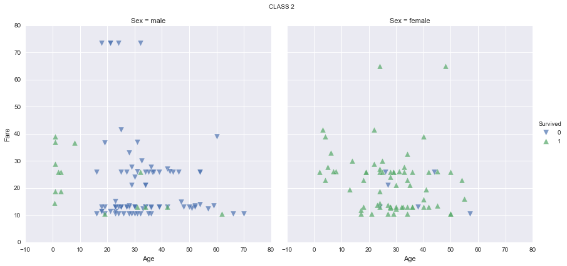
Age vs. Fare - Scatter Plot

Slide 5
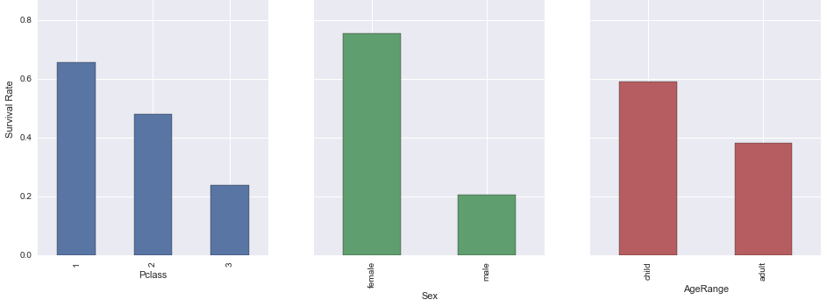
Bar chart for pclass, gender and age

Slide 6
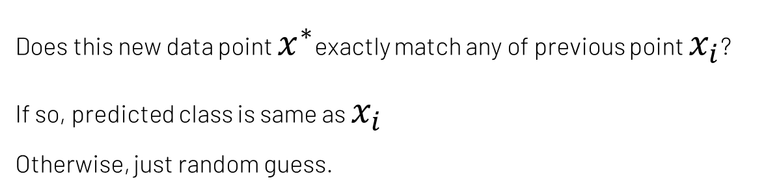

A Very Naïve Classifier
Survived | Pclass | Sex | Age | SibSp | Parch | Fare | Cabin | Embarked
1 | 1 | Female | 35 | 1 | 0 | 53.1 | C123 | S
Point $x^{∗}$
Does this new data point $x^{∗}$exactly match any of previous point $x_{i}$?
If so, predicted class is same as $x_{i}$
Otherwise, just random guess.
Rote Classifier

Slide 7
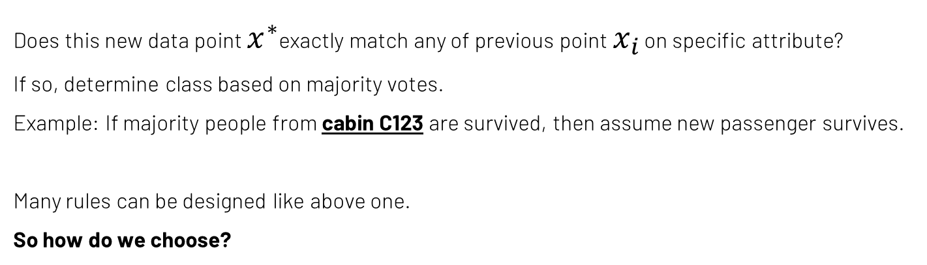
Minor improvement in Naïve Classifier
Survived | Pclass | Sex | Age | SibSp | Parch | Fare | Cabin | Embarked
1 | 1 | Female | 35 | 1 | 0 | 53.1 | C123 | S
Point $x^{∗}$
Does this new data point $x^{∗}$exactly match any of previous point $x_{i}$ on specific attribute?
If so, determine class based on majority votes.
Example: If majority people from cabin C123 are survived, then assume new passenger survives.
Many rules can be designed like above one.
So how do we choose?
Improved Classifier

Slide 8
THANKS!
@saifhassandr
Any questions?
Leave comments below.

